Slide 1
Employee Data Analysis using Excel
STUDENT NAME: KEERTHANA SRI K.S
REGISTER NO: 312219906
DEPARTMENT:B.COM(GENERAL)
COLLEGE: PERI COLLEGE OF ARTS AND SCIENCE
NM ID: B875B71B1BBB7989260472DCD7FE0F97

Slide 2
PROJECT TITLE
Employee Performance Analysis using Excel

Slide 3


AGENDA
Problem Statement
Project Overview
End Users
Our Solution and Proposition
Dataset Description
Modelling Approach
Results and Discussion
Conclusion
3/21/2024 Annual Review

Slide 4

PROBLEM STATEMENT
Analyzing employee performance using Excel helps organizations make data-driven decisions to enhance productivity, address skill gaps, and recognize achievements, ultimately leading to improved overall performance and employee satisfaction.

Slide 5

PROJECT OVERVIEW
summary of a project overview for data analytics using MS Excel.
Project Title: Data Analytics using MS Excel
Objective: To leverage MS Excel's data analytics capabilities to extract insights, identify trends, and inform business decisions..
This project aims to demonstrate the power of MS Excel in data analytics, providing actionable insights to drive informed business decisions.

Slide 6

WHO ARE THE END USERS?
Employee
Employer
Organization
Firm

Slide 7

OUR SOLUTION AND ITS VALUE PROPOSITION
Filtering in Excel allows you to selectively display and analyze specific subsets of data based on criteria, enabling focused insights and streamlined data management.
Groups in Excel help organize and manage data by allowing users to collapse or expand sections of related rows or columns, facilitating better data navigation and analysis.
A Pivot Table in Excel is a powerful tool that summarizes, analyzes, and presents large datasets by organizing data into rows, columns, and values for dynamic and interactive reporting.

Slide 8
Dataset Description
There is 5 features in employee dataset.
Business unit : "Business Unit," "Revenue," "Expenses," "Profit," and "Market Share" to clearly present and compare metrics for each unit.
Performance score : Conditional Formatting Apply conditional formatting to highlight high or low performance scores for better visualization.
Current employee rating : Number Format Ensure that the Rating column is formatted to show numbers or a rating scale if applicable.
performance level gender :Create a summary table to analyze performance levels by gender. This table will help you visualize the data more effectively.

Slide 9

THE "WOW" IN OUR SOLUTION
Performance level FORMULA :
IFS (Z8-5”VERY HIGH”28-4,”HIGH”,28>3,”MED”,TRUE,”LOW”)
3/21/2024 Annual Review
9

Slide 10
MODELLING
Use PivotTables for Advanced Analysis
PivotTables can dynamically summarize and analyze your data:
Select Your Data Range.
Go to Insert > PivotTable.
Configure PivotTable:
Rows: Project Name or Department.
Columns: Performance Metrics.
Values: Average or Count of Performance Metrics.
Incorporate Conditional Formatting
Highlight key performance metrics:
Select Cells: Highlight the range of performance data.
Conditional Formatting: Go to Home > Conditional Formatting > Color
Scales or Data Bars to apply formatting based on performance values.
10

Slide 11
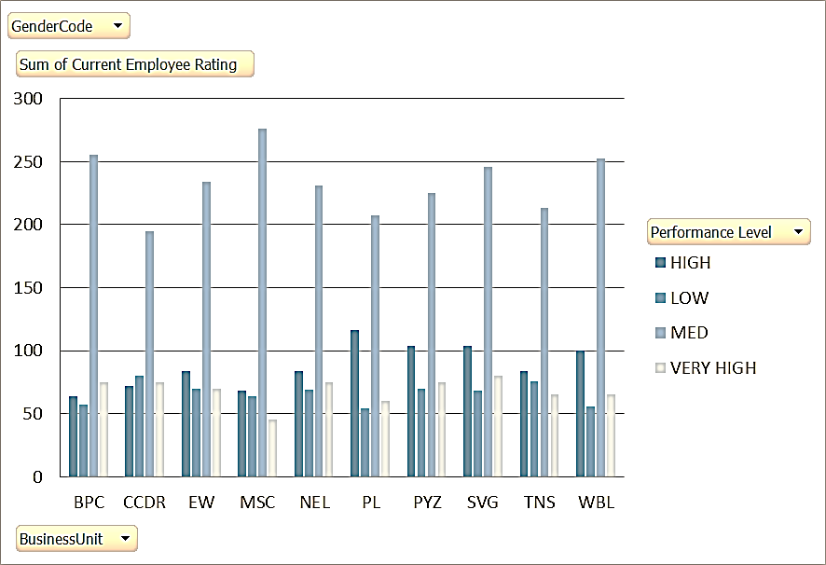
RESULTS
11

Slide 12
conclusion
In summary, creating an effective employee performance analysis model in Excel involves several key steps to ensure you can track, analyze, and visualize data efficiently:
Data Organization: Start by structuring your data in a well-organized table, including essential fields such as Employee ID, Name, Gender, Department, Project ID, Performance Metrics, and Ratings.
Summary Tables: Develop summary tables to aggregate data by projects and departments. This helps in understanding overall performance trends and making comparisons.
Visualization: Utilize charts and graphs to visually represent performance data. Bar charts, pie charts, and line graphs can provide clear insights into how employees are performing across different projects and departments.

